Slide 1
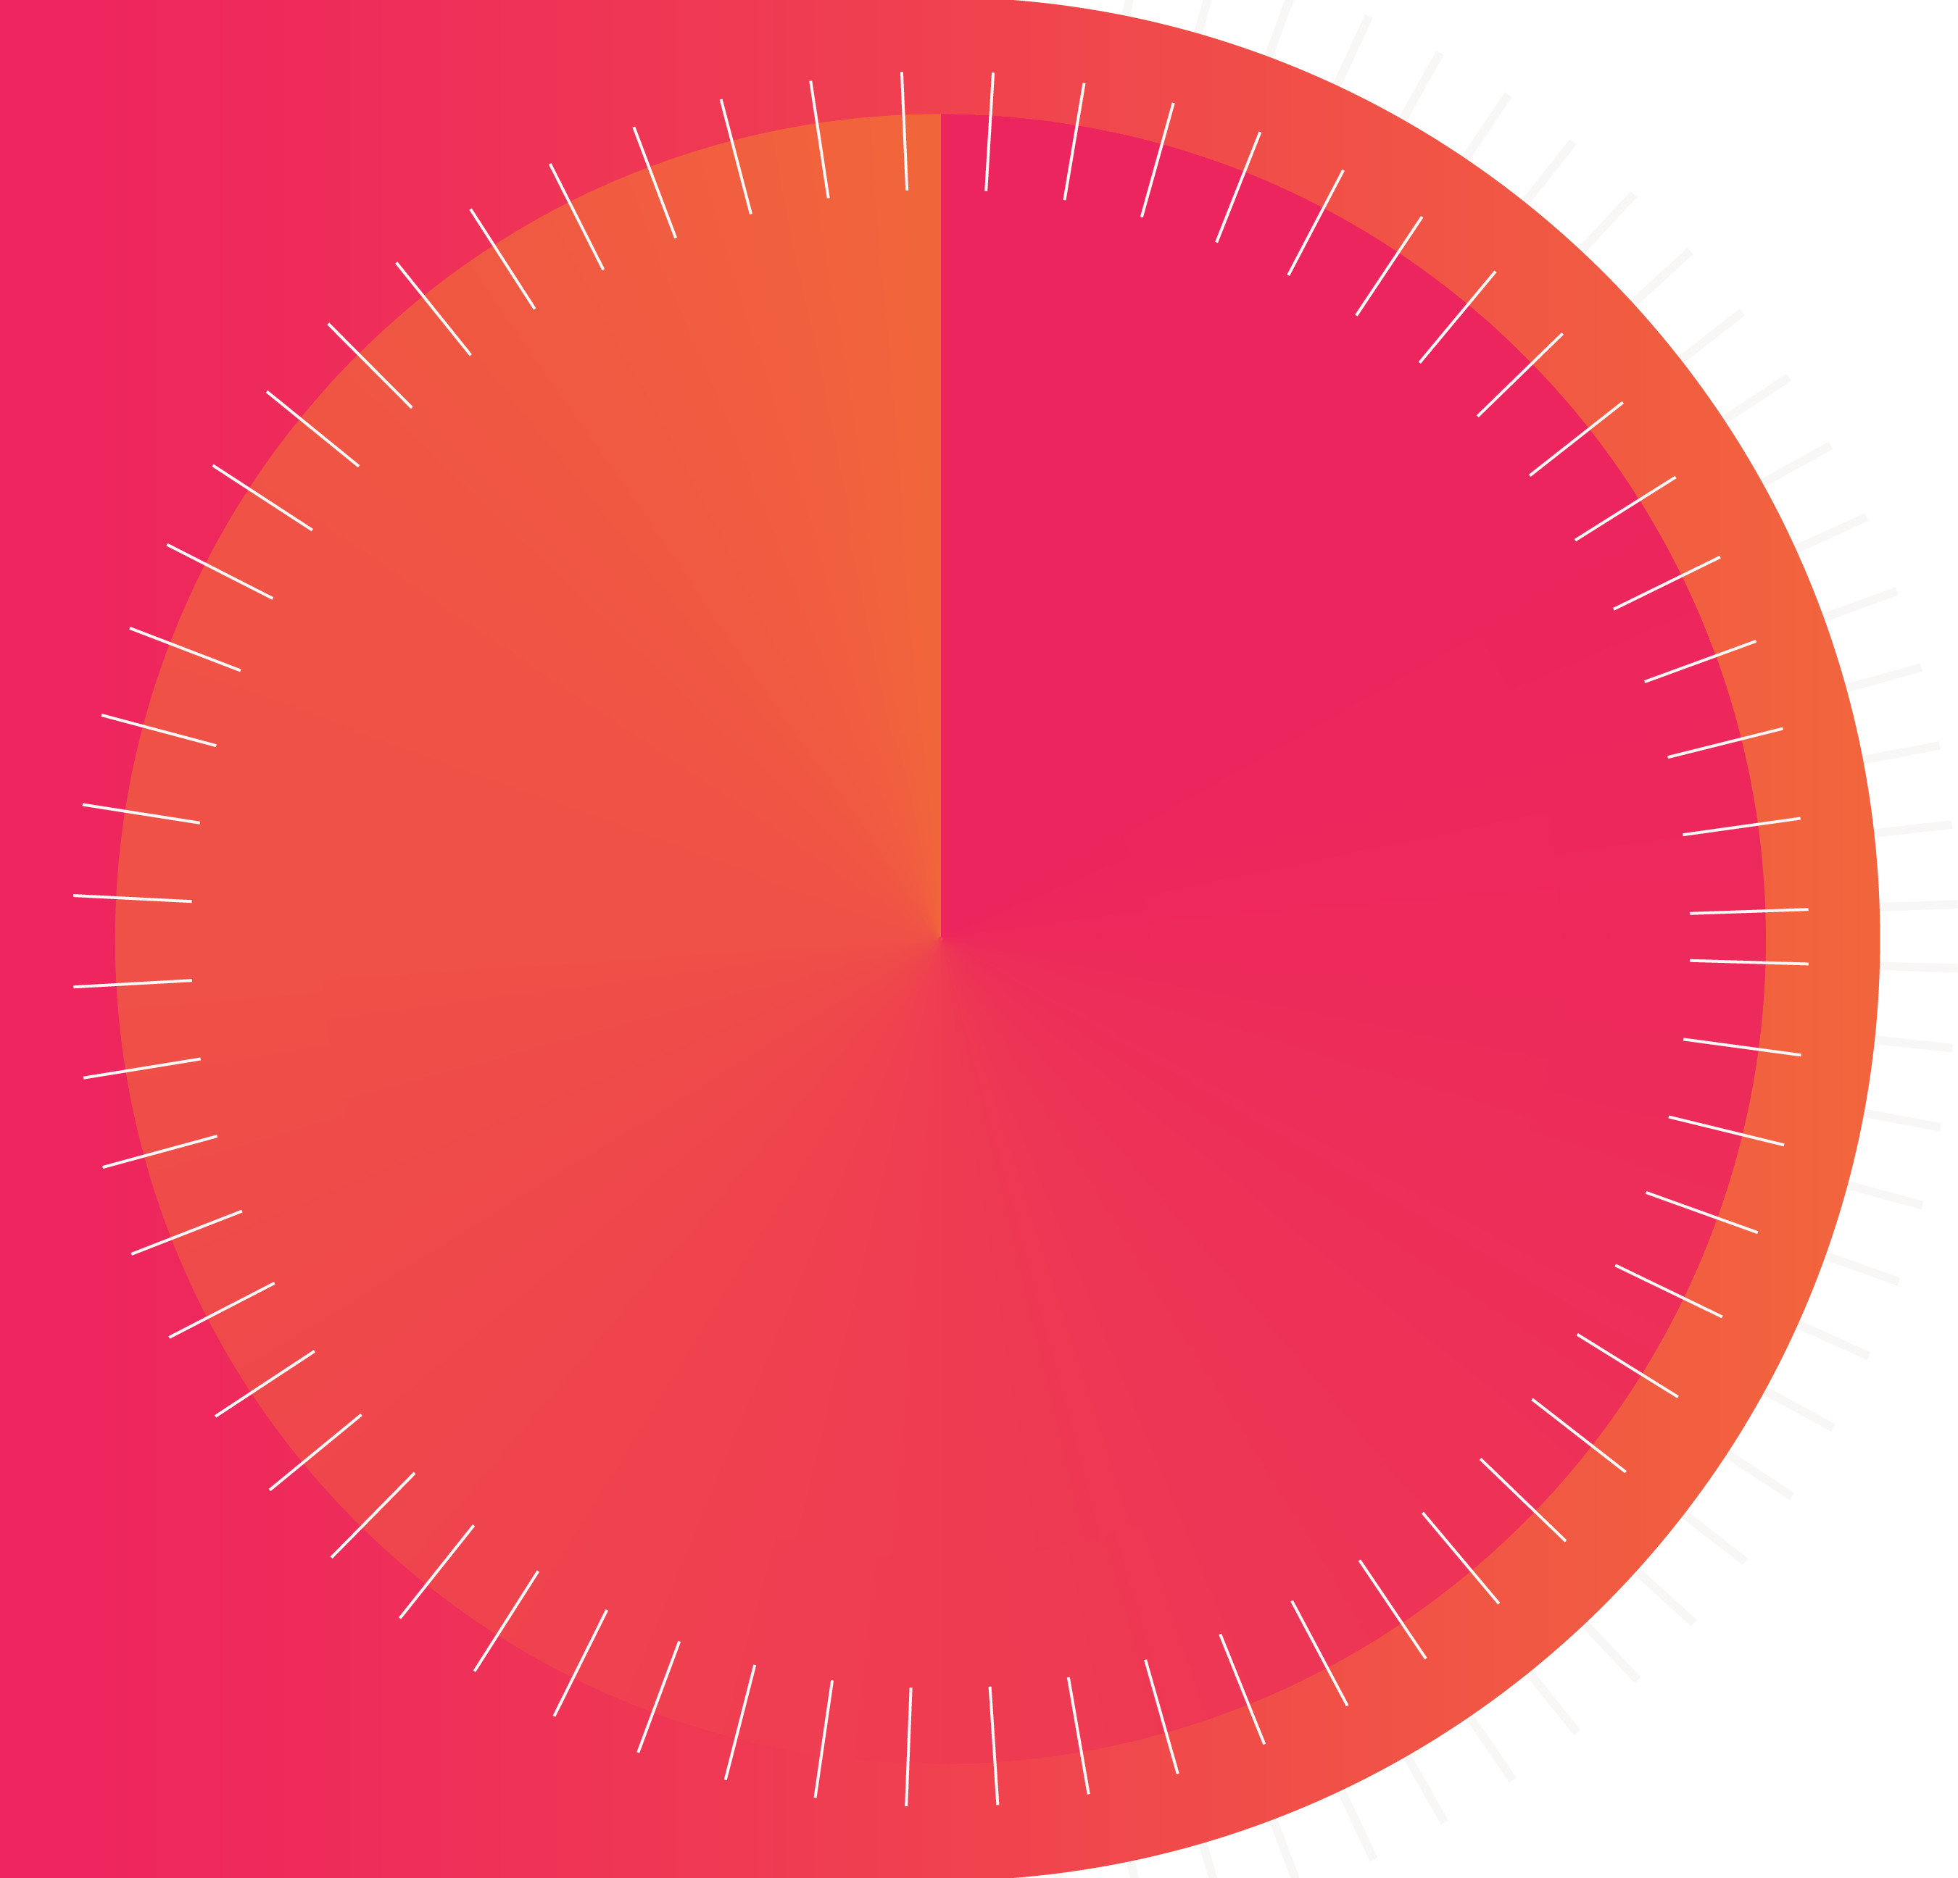


Kaya 959 Reasons To Switch
February 2023

Slide 2
The Kaya 959 Listener
Kaya 959 speaks directly to the Code Switcher. Code Switching is a mindset that describes the unique duality of this audience. Code Switchers possess an ability to move from a township to a suburban experience with ease.
They can move from one language to another in a single sentence. The Kaya 959 Code Switcher is on a journey of personal growth, and they are driven to succeed. Kaya 959 provides them an authentic, welcoming environment where they feel included, and they are accepted for who they are.

Slide 3
Code Switcher key drivers & life values
FAMILY
THEY DRIVE PURCHASING
Code Switchers are rooted in family. It’s the most important thing to them. 69% have children ad they enjoy spending time with their families.
88% of Code Switchers play a key role in making day-to-day household purchasing decisions. As key decision makers, they play a vital role in the consumer buying process. This represents a prominent group of consumers that brands need to engage with.
SELF-CONFIDENCE
THEY ARE EDUCATED
Code Switchers are confident in their identity and the place they occupy in the world. They are non-conformists - “People have to take me as they find me”
More than half of Kaya listeners are educated. Education is important to them and considered key driver of wealth. It is a crucial steppingstone for personal and career advancement.
ADVENTURE SEEKERS
HEALTH CONSCIOUS
Majority of Kaya listeners have a keen sense of adventure. They prefer spending money on experiences rather than tangle items. They are also outgoing and sociable.
Our listeners are conscious about their overall wellbeing. Being fit and leading a healthy lifestyle is important to them.
Source : BRC RAMS AMPLIFY January-December 2022, TGI 2022A, Brandmapp 2022

Slide 4

The Radio Awards honour and recognise exceptional and innovative excellence in the South African radio industry. It sets a benchmark for all radio stations and professionals to strive towards.
This programme is dedicated to fairness and integrity and is focused on being a credible, well-judged and transparent programme.
Source : https://twitter.com/saradioawards?lang=gu and Radio Awards 2022

Slide 5


Source : https://twitter.com/saradioawards?lang=gu and Radio Awards 2022

Slide 6


Source : https://twitter.com/saradioawards?lang=gu and Radio Awards 2022

Slide 7
Code Switchers that fall into the upper end affluent segment of the market have an average household income that is above the national average, the total radio listening market and the upper end segment.
They represent a prominent group of consumers that brands must continue to engage with.
Source : BRC RAMS AMPLIFY November 2021 – October 2022

Slide 8

Code Switchers mostly respond to advertisements curated in the form of interviews, sponsored content and those that incentivize them.
Competitions are a highly recognized form of advertising for the Kaya 959 audience. When it comes to radio, social media and online advertisements, 55% of Code Switchers mostly respond to competitions. A third of them respond to interviews and 1 in 5 respond to sponsorships. About 2 in 5 have purchased products/service after hearing about them on radio in the past year.
Source: Kaya 959 Radio Check 2022 n=1221

Slide 9
Code Switchers consider Radio to be a leading and trusted content source
Kaya listeners have access to a variety of platforms when seeking knowledge, news, music, entertainment and lifestyle content, however, radio remains a number one trusted media source for the delivery of this information. They are aware of the other sources at their disposal, but still prefer consuming radio content.
Source: Kaya 959 Radio Check 2022 n=1221

Slide 10

Code Switchers are discerning shoppers with a positive outlook with regards to shopping attitudes
More than half of the listeners always lookout for sales and discounts
53%
They are loyal to well-known brands and shops they know and trust
43%
Grocery store motivation is determined by most convenient location
40%
They are more likely than the population at large to buy things that are eco-friendly
Index = 116
Quality is more important than convenience
51%
Source : Brandmapp 2022A

Slide 11

Brands have access to Code Switchers that are well established and highly influential
Majority of Code Switchers that fall into the middle and affluent markets are decision makers that are either wholly or partly responsible for day-to-day purchasers within their households.
Middle SEM 5-7 Market
Kaya 959 86%
Upper SEM 8-10 Market
Kaya 959 88%
Source : BRC RAMS AMPLIFY November 2021 – October 2022

Slide 12

Brand have access to loyal Code Switchers throughout the week
On average, more than half of Code Switchers that fall into the middle and affluent markets are heavy listeners who tune in almost everyday (6 or 7 days a week).
Middle SEM 5-7 Market
Kaya 959 48%
Middle Market Average
38%
Upper SEM 8-10 Market
Kaya 959 54%
Upper Market
Average
41%
Source : BRC RAMS AMPLIFY November 2021 – October 2022

Slide 13


Code Switchers are educated and heavy Radio listeners
Kaya 959 ranks number 1 for the educated Black middle to upper class market with the highest listeners that have matriculated, completed University and have post graduate qualifications compared to Gauteng’s regional commercial stations.
Our listeners are dedicated to personal growth and improving their career prospects.
Kaya 959 ranks number 1 in listenership with the highest number of Black regular radio listeners among Gauteng commercial radio stations. They listen to the radio 6 or 7 days a week.
Our listeners are committed to the station and the content genres resonate with them.
Black Adults Aged 15+ SEM 5-10 Residing in Gauteng
(Matric, University Completed and Post Graduate Qualification)
Kaya 959
283 000
947
248 000
702
210 000
Power FM
95 000
Black Adults Aged 15+ SEM 5-10 Residing in Gauteng (Listen to Radio 6 or 7 times a week)
Kaya 959
251 000
702
205 000
947
178 000
Power FM
106 000
Source : BRC RAMS AMPLIFY November 2021 – October 2022

Slide 14
Code Switchers drive majority of purchasing in Gauteng
Kaya 959 is highly competitive and popular amongst Black adults residing in Gauteng.
The core target market is urban, black middle to upper class listeners between the ages of 25 and 49 residing in Gauteng.
Kaya 959 listeners are economically active. More than half of the listeners, 55% (394 000) are employed (the rest are either Housewives, Students or Retired).
For consumers residing in Gauteng, Kaya 959 ranks number 1 in listenership for the mature middle to affluent, economically active Black consumers Aged 25-49 in SEM 5-10 compared to other Gauteng based stations. The average age for the Kaya 959 listener is 37.
They are 6 times more likely than the population at large to fall within this segment of the market.
Majority of the listeners are employed and are either working full or part time, Kaya 959 ranks number 1 within that segment compared to its competitors.
Black Adults Aged 25-49 SEM 5-10 Residing in Gauteng
Kaya 959
340 000
947
280 000
702
198 000
Power FM
103 000
Black Adults Aged 15+ SEM 5-10 Residing in Gauteng : (Working Full/Part Time)
Kaya 959
279 000
947
228 000
702
199 000
Power FM
101 000
Source : BRC RAMS AMPLIFY November 2021 – October 2022

Slide 15


THANK YOU

